Slide 1

OSLO Core Consent
Welcome! We will start at 1:05pm.
Thursday 16th December 2021
Virtual Workshop - Microsoft Teams
Digitaal Vlaanderen

Slide 2

Purpose of today
Summarise the third thematic workshop
Present the new iteration of the data model
Test use cases of the previous workshop on the model
Elaborate on definition & resolution

Slide 3



Practicalities
Sound of the audience is muted by default.
Use the hand if you want to say something. Interaction is encouraged!
Questions, comments and suggestions can be communicated via the chat function. Interaction is encouraged!
Yes/No questions can be answered via the chat:
Agree = +1
Disagree = - 1
Indifferent = 0

Slide 4

Recording

Slide 5


Agenda
Welcome: Who is who 5 min
Summary of the previous workshop 15 min
New iteration of the data model 60 min
15 min. break
Use cases 40 min
Definitions 5 min
Q&A and next steps 10 min

Slide 6

Who is who?
5’
https://app.mural.co/t/beadvtc7549/m/beadvtc7549/1638992315995/410030e18e063e729a441f5a4efaf18071ac1e45?sender=u91199267117038c13b019919

Slide 7
Rationale for this trajectory
Digitaal Vlaanderen

Slide 8
What is TRAPEZE?
TRAPEZE is a project, financed by the European Commission, that delivers a platform as a solution for organisations and citizens with some concrete objectives on security and privacy.
It aims to:
Bring stakeholders together under a common framework;
Provide citizens with the necessary tools and know-how to manage their security and privacy;
Supporte consent mechanisms and verifying that data is used appropriately;
Restore citizens' trust in the digital economy by implementing 'log integrity' and 'non-repudiation';
Build up 'data lineage' and 'transparency by design' and
Illustrate its usefulness by applicing it in 3 domains, namely government, telecom and financial sector.

Slide 9
What is expected?
Common data standard for “consent”
The objective of this project is to manage the consent of an agent’s data exchange in a uniform, standardised and machine-interpretable manner.
2-part objective, namely:
OSLO trajectory
Application profile for a wide range of use cases, i.e.:
As a citizen
As a business party using a permission
Use cases relating to delegation of consent
Co-creative trajectory for the development of an unequivocal data standard concerning core consent.
Involving the main stakeholders (federal and regional authorities, local authorities, private organisations) in order to develop a data standard that is supported as broadly as possible

Slide 10
Summary of the previous workshop
Digitaal Vlaanderen

Slide 11


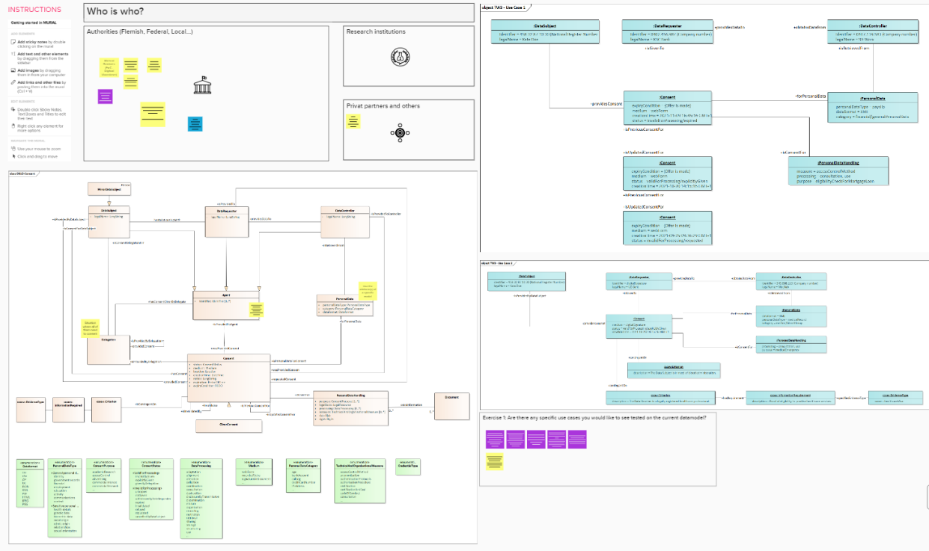
What did we do in the previous workshop?
Summary of the previous workshop
New iteration of the data model
Brainstorm session on use cases
Github issues discussed through use cases
Give consent to salary data for a mortgage loan
Give consent to blood group info in case of a medical emergency
Different Agents within Consent
Agent as super class with the attribute identifier
Addition of CCCEV classes
Higher granularity for PersonalData
Extra options for the status of Consent
Purpose and relationship within the model
Adding the class Document for DataSubject in a human-readable way

Slide 12
Question from the previous workshop
How do we ensure the persistent publication of standards, e.g. to avoid that a page goes 505?
Application profiles and definitions from Digital Flanders are persistent. This means that those will not disappear.
However, when we reuse definitions from other sources, we refer to vocabularies outside of the governance of Digital Flanders. That is why reuse should be tied to data standards that we expect to have good governance.

Slide 13
What does the planning look like?
OSLO-traject
Start date: 19th of August 2021
Duration: 8 months
19th of August
23th of September
18th of November
16th of December
January - March
21th of October
Business workshop
Thematic workshop 1
Thematic workshop 3
Thematic workshop 4
Implementation of the draft specifications
Thematic workshop 2
Today

Slide 14
New iteration of the data model
Digitaal Vlaanderen

Slide 15
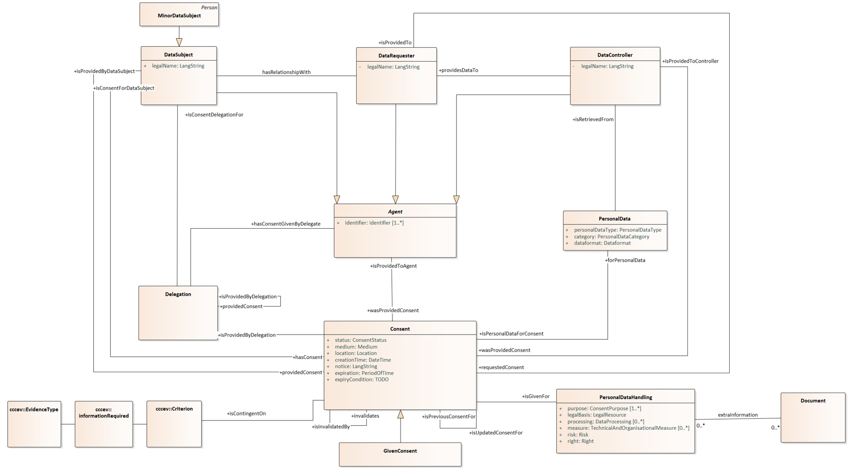
Previous iteration of the data model

Slide 16

High level changes to the draft model
Foresee a possibility to guarantee the granularity of the personal data
Make the link with existing data models and reuse as much as possible
Align the model with GDPR terminology as much as possible by
changing the use of the involved agents;
introducing the legal bases of GDPR in the data model; and
adding the class DataRetention to define the retention period of the data
Propose a solution for the expiry conditions issue and use of CCCEV for unquantifiable conditions
Elaborate on the enumerations
Changes to the class PersonalDataHandling
Deleting the superclass Agent

Slide 17
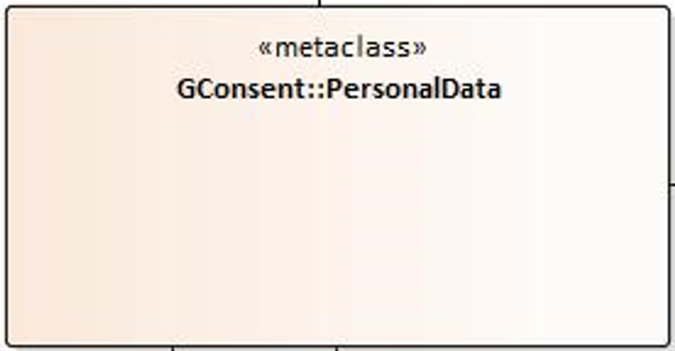
1. Granularity of the personal data
To maintain a maximal granularity when referring to the personal data, we will use a metaclass. A metaclass is a class of which the instances are classes themselves.
Meaning: the metaclass PersonalData can be every class that is personal data.
This PersonalData class can be reused from GConsent as it is also being used as a metaclass in there.

Slide 18
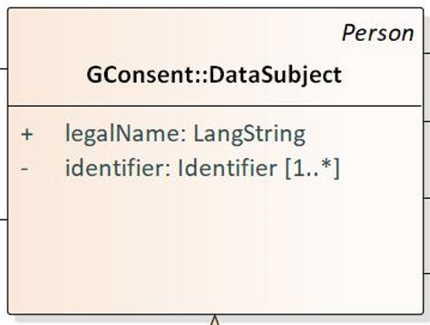
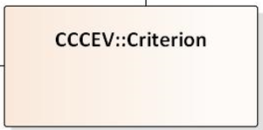
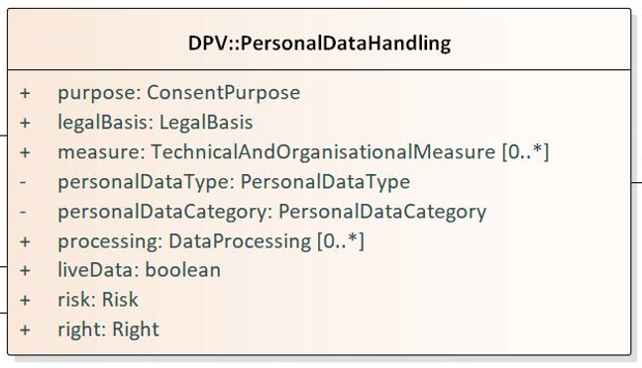
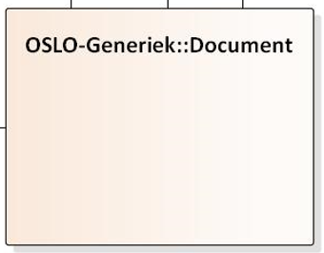
2. Link with existing data models
The data model maximises the reuse of existing vocabularies and data models to:
substantiate the consistency and linking between models;
inherit the properties of those classes; and
avoid duplication of work
The data models that were used within our model are
GConsent: ontology for representing consent for GDPR compliance
Data Protection Vocabulary (DPV): provides terms to describe and represent information related to processing of personal data
Core Criterion and Core Evidence Vocabulary (CCCEV): used to respond to these criteria by means of evidences
OSLO-Generiek: only one class is used which defines the identity of the responsibles, the planned processing, the purpose, the legal basis and measures to protect a persons data

Slide 19
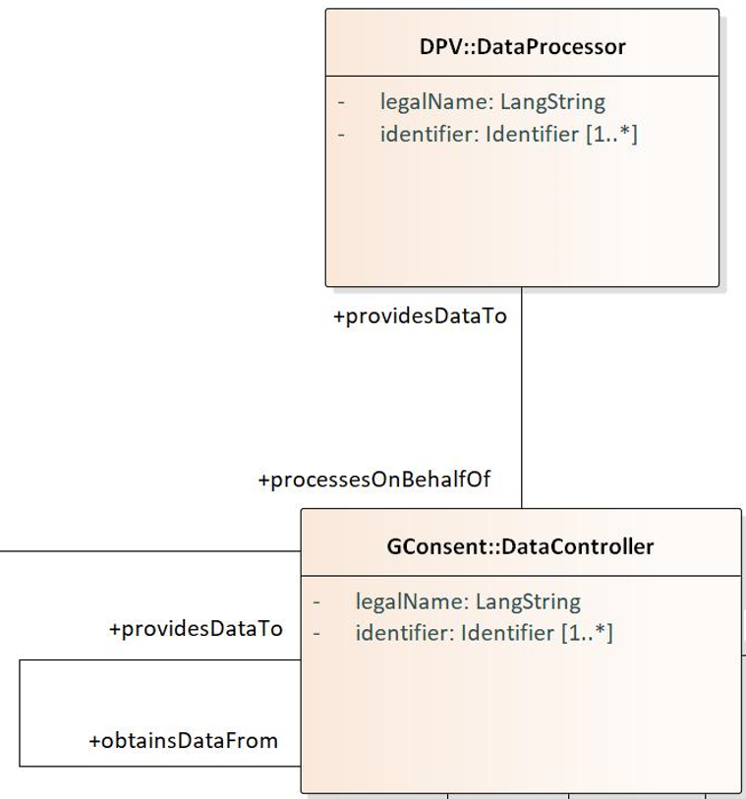

3.a Change the use of the involved agents
Data subject, data controller and data processor are three terms that are widely used in GDPR, but also clearly defined. Hence, it is important to use those terms correctly in the model.
DataSubject: The individual (or category of individuals) whose personal data is being processed
DataController: Person or organisation that decides (or controls) the purpose(s) of processing personal data.
DataProcessor: Processes personal data on behalf of the controller.
So, what did we change?
No DataRequester anymore: both roles (of the organisation sharing and the one requesting) could be defined by the class DataController
Added DataProcessor for situations in which the controller uses another party to process the data

Slide 20
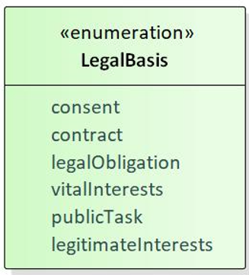
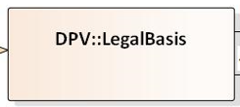
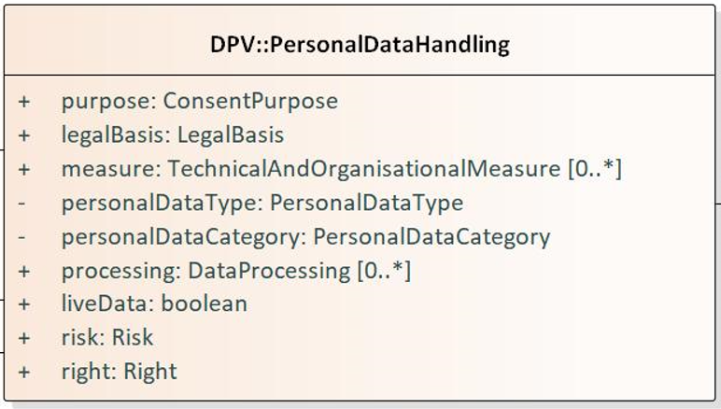
3.c Introducing the legal basisses of GDPR in the data model
GDPR defines six lawful basis for the processing of personal data, with consent only being one of those.
Consent: individual gives clear consent to process their personal data for a specific purpose
Contract: the processing is necessary for a contract you have or will have
Legal obligation: processing is necessary to comply with the law
Vital interest: to protect someone’s life
Public task: to perform a task in the public interest or for your official functions, and the task/function has a clear basis in law
Legitimate interests: for legitimate interests of you or a third party, unless a good reason to protect the data overrides it
So, what did we change?
Added the class LegalBasis as a superclass of Consent
Added it as an attribute to the classes PersonalDataHandling and DataRetention (next slide), defining the legal basis on which the data handling or retention is based

Slide 21
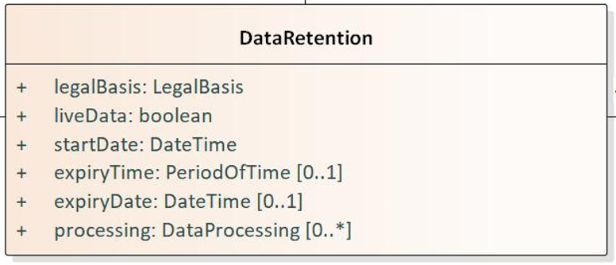
3.d Adding the class DataRetention
Added the class DataRetention to the model to
indicate in the model if data needs to be kept longer than for the sole purpose of the consent; and
introduce the dataprocessing which is based on the other legal basisses
Some clarification on the attributes
LiveData: shows if the DataRetention is about the need to have access to the latest version of the data or if it is about a copy of the data used during the validity period of the consent
Processing: identifies the type of processing for which a retention period was started

Slide 22
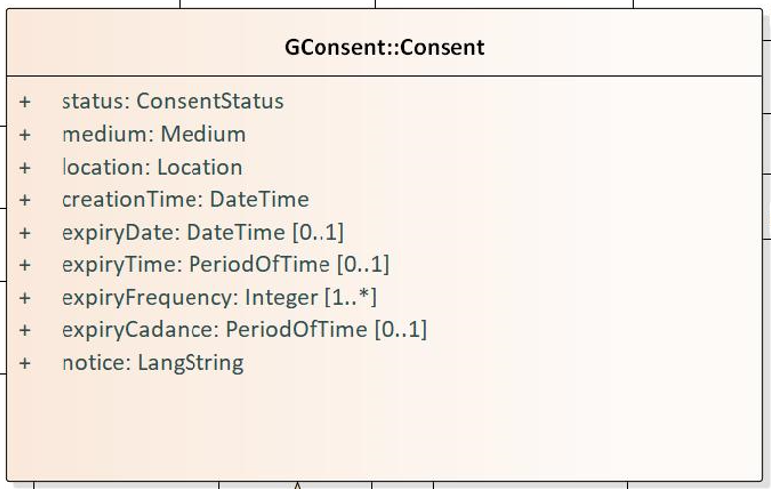
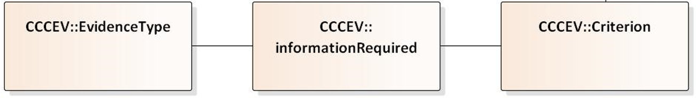
4. Expiry conditions and CCCEV
Two options to address this:
Option 1: Making the expiry conditions solely quantifiable. The attributes used to do this are
expiryDate: date on which the Consent should expire;
expiryTime: the time after which a consent should expire after being validated;
expiryFrequence: the number of times the consent may be used before it expires; and
expiryCadance: the period between two uses of the consent
Option 2: Adding event-based expiry conditions to the model by using the CCCEV classes in a similar way as used for contextual and credential consent.
The use cases are used to show both options.

Slide 23
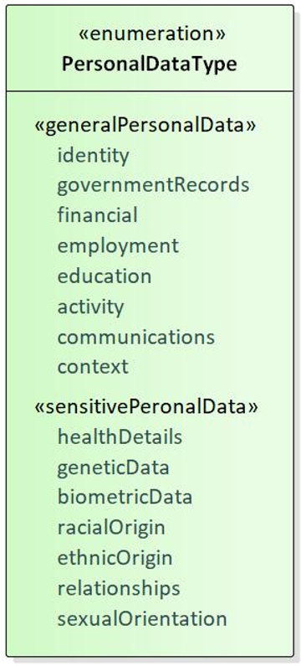
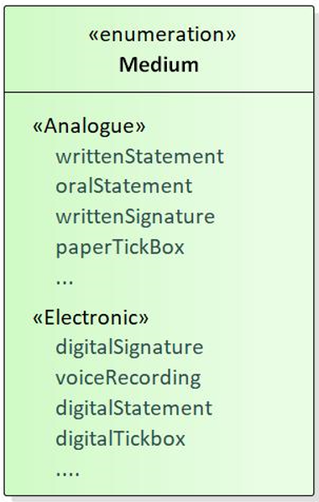
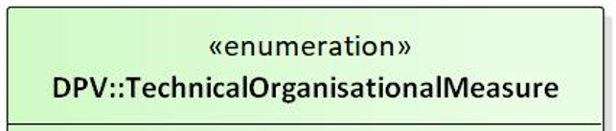
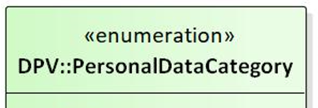
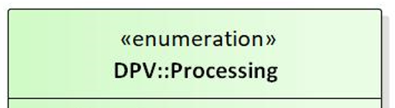
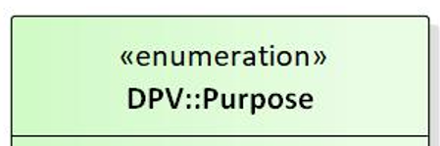
5. Enumerations
The enumerations within the data model have been elaborated on and aligned with the GDPR. DPV has already identified lists for several of these enumerations, to which can be reused.
We would like to highlight some of them:
PersonalDataType: exhaustive list of high level data types
Medium: non exhaustive list of ways to express consent
DataProcessing: DPV list of 40 options
ConsentPurpose: DPV list of 64 options
TechnicalAndOrganisationalMeasures: DPV list of 48 options
PersonalDataCategories: DPV list of 170 options, lower level than PersonalDataType

Slide 24
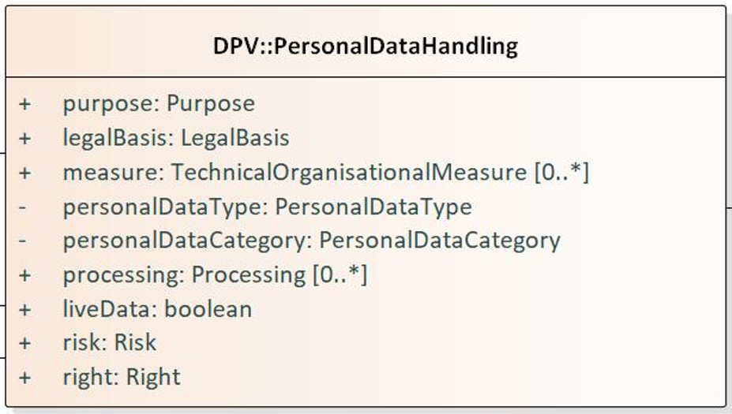
6. Changes to the class PersonalDataHandling
Some changes have been made to the PersonalDataHandling class since the previous model:
As it is being inherited from DPV the same naming has been taken
The attribute legalBasis is also part of the class, however within the scope of this model the legalBasis will always be Consent
personalDataType and personalDataCategory were moved to this class as the PersonalData class is now a metaclass
liveData attribute was added to indicate if the recipient of the data requires access to the live data (yes) or only needs a static version of the data (no)

Slide 25
7. Deleting the superclass Agent
Following a GitHub issue, the superclass Agent was deleted.
Added value of the class was questionable
Generalisation of the relation between Agent and Consent was an opening for misinterpretation rather than a clarification
The change of the relations between DataSubject, DataProcessor and DataControllor only made the risk for misinterpretation bigger
It makes the data model clearer and creates room for defining more crucial associations

Slide 26
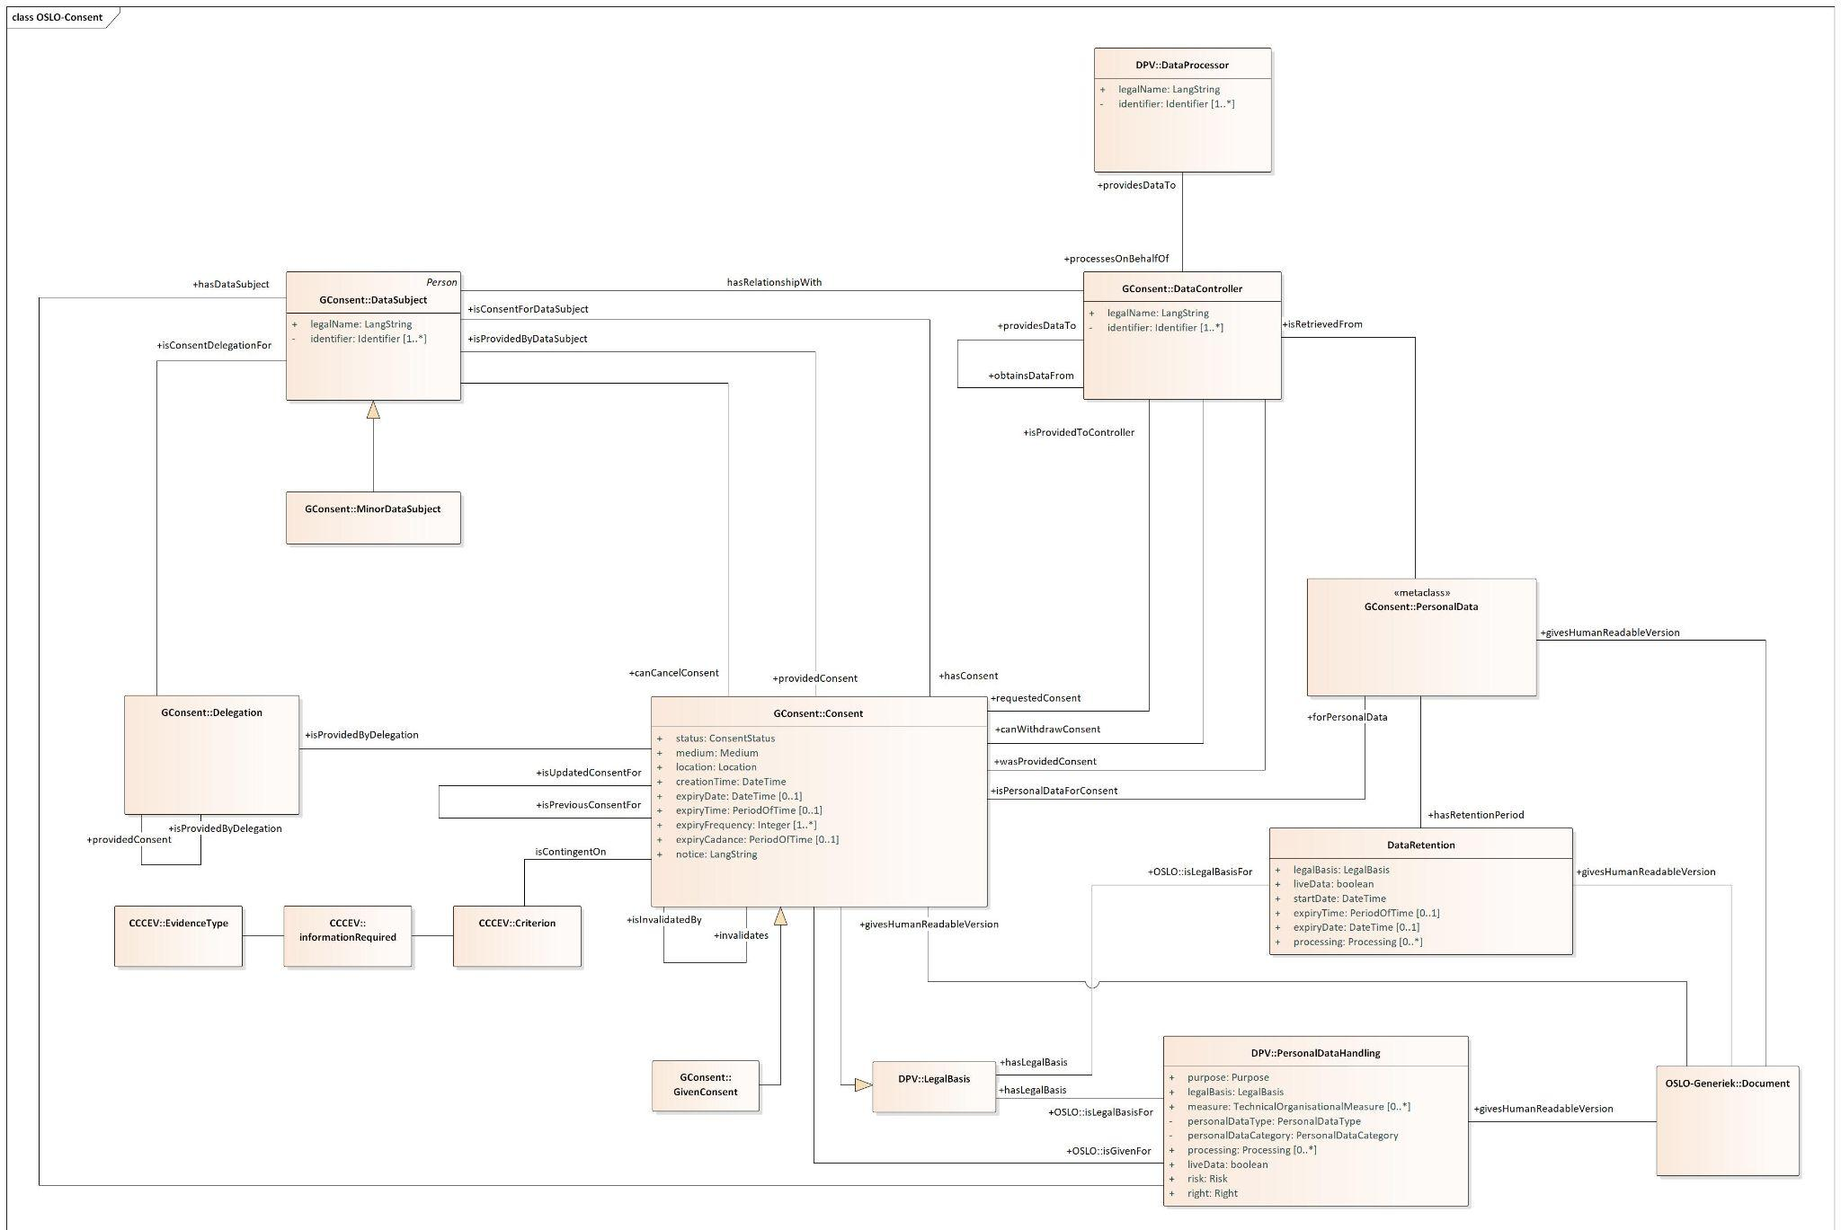
Current iteration of the data model

Slide 27

A short break...

Slide 28

Welcome back!

Slide 29
Use cases
Digitaal Vlaanderen

Slide 30
Case 1 – Multi-person consent for bank transfer data in function of Alimony support
DAVO (Dienst Alimentatiebevorderingen i.e., Alimony Claims Service of Belgium) wants to automate the advances they give to parents not receiving their alimony (in time).
Sarah Peeters is a mother with full custody over their child. The father the child, Richard, is not able to pay the alimonies of the children according to the requirements put in place by the judge.
To be able to automate the processes DAVO requested consent from Sarah Peeters and Richard to access the money transfers from Richards bank account to Sarah's bank account .
As their child just became 14 years old they ask for the consent to last for the next 4 years, so that they are able to provide their services until the child is 18 years old (legal age for adulthood in Belgium) and no longer required to receive alimony. Richards is expected to pay Sarah on a monthly basis, meaning DAVO should have access to the data in the same cadence.

Slide 31
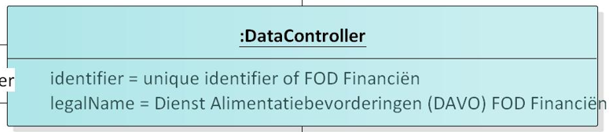
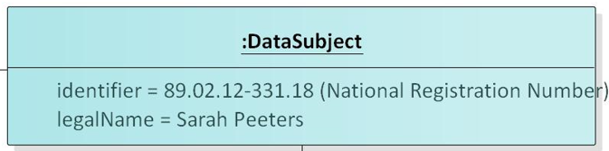
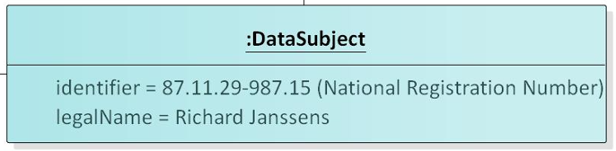
1. Sarah Peeters, Richard Janssens and DAVO (Dienst Alimentatiebevorderingen i.e., Alimony Claims Service of Belgium) are involved in the consent
Multiperson consent-story
DAVO being an instance of FOD Financiën
As DAVO is deciding why and how they will be processing the data, they are data controllers in this case
Sarah Peeters and Richard Janssens are both data subjects, identified by their National Registration Number

Slide 32

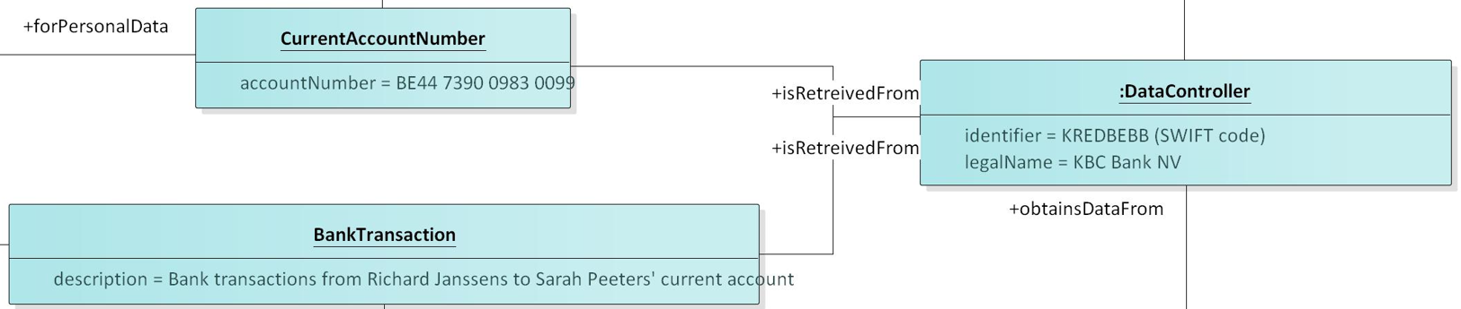
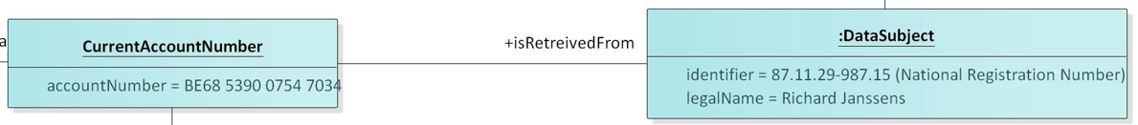
2. To be able to automate the transaction DAVO needs consent to the current account number of both datasubjects and consent to the bank transactions that take place between both accounts.
Sarah’s data is retrieved from her bank (KBC), which is a data controller of the data
Richard’s data is retrieved from himself in the form of webform, asking him to give in his current account number
The personal data are here specific classes of personal data. Keeping the granularity as high as possible.
No check was done if the used classes do exist or not, but in practice it is possible to use any existing class in here which relates to personal data.

Slide 33
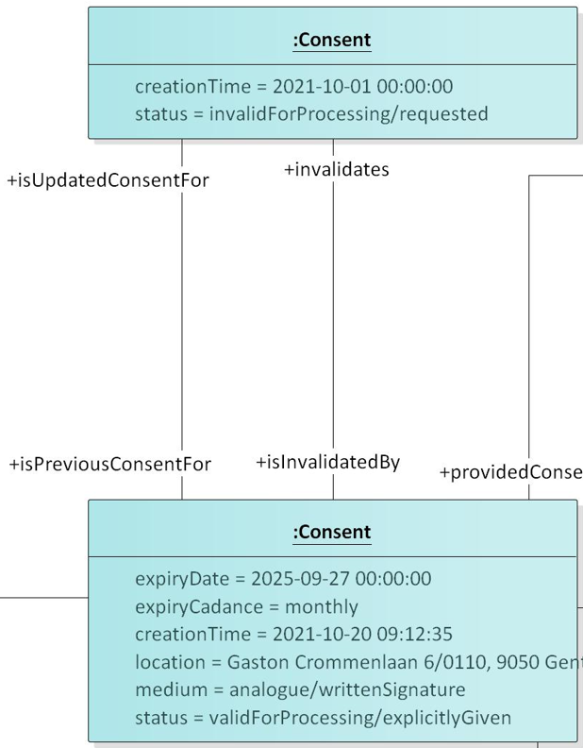
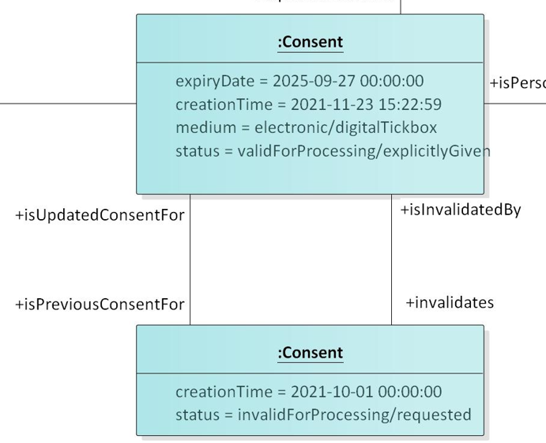
3. A consent request was made for both of them and both gave consent for processing the data until their youngest daughter is 18 y/o.
Two separate consent requests were made on the 1st of October 2021
Both of them were asked to give consent to the data relevant for their case
Richard gave consent digitally via a tick box in the webform on 23/11/2021
Sarah gave consent physically by signing a document at DAVOs office on 20/10/2021
The bank transactions need to be monitored on a monthly basis
As their youngest daughter becomes 18 y/o on 27/09/2025 the consent expires at that moment in time

Slide 34
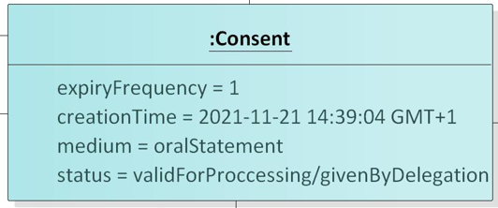
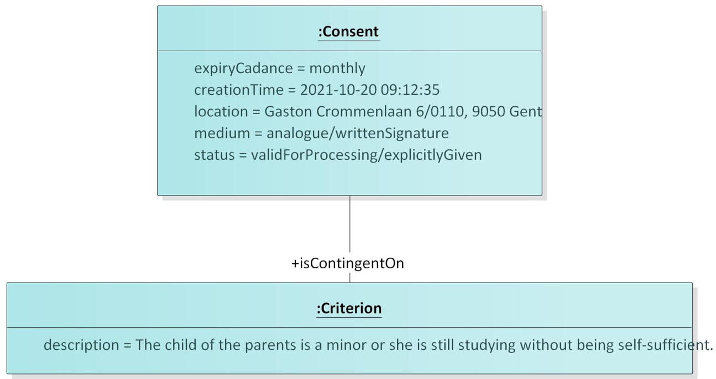
Options for expressing the expiry conditions
Option 1:
Their daughter becomes 18 y/o, so the consent expires at this moment in time. When the consent expires the situation has to be analyses again and a new expiry date will be determined.
Option 2: The CCCEV objects are used to determine and check the criterion which should be met for the consent to still be valid.
→ Event-based expiry conditions are being seen as contextual/credential consents
Provide your input by posting in chat:
0 = indifferent; 1 = Option 1; 2 = Option 2

Slide 35
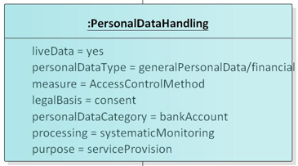
4. A machine learning tool will systematically monitor the bank transactions to make sure that Sarah receives the alimony she needs
As the data changes on a monthly basis it is important to have access to the live data
Type of processing that the machines will perform is systematic monitoring
And the purpose is to obtain the advance payment service from DAVO

Slide 36
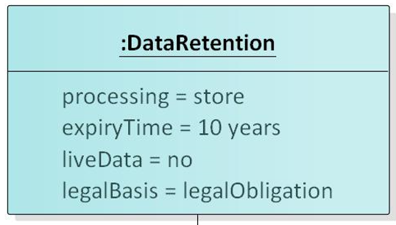
5. Next to the data processing related to the consent, DAVO needs to have a retention period for the data. Because they need to store the data for 10 years due to legally determined auditing reasons.
All the personal data types have a DataRetention object associated with it
Processing that may be performed in this time is storing the data
The period is 10 years after receiving the data
It is not liveData that is needed, as they just need the data received at the moment of the consent
The legal basis behind this retention is a legal obligation which was set by the authorities for auditing reasons

Slide 37
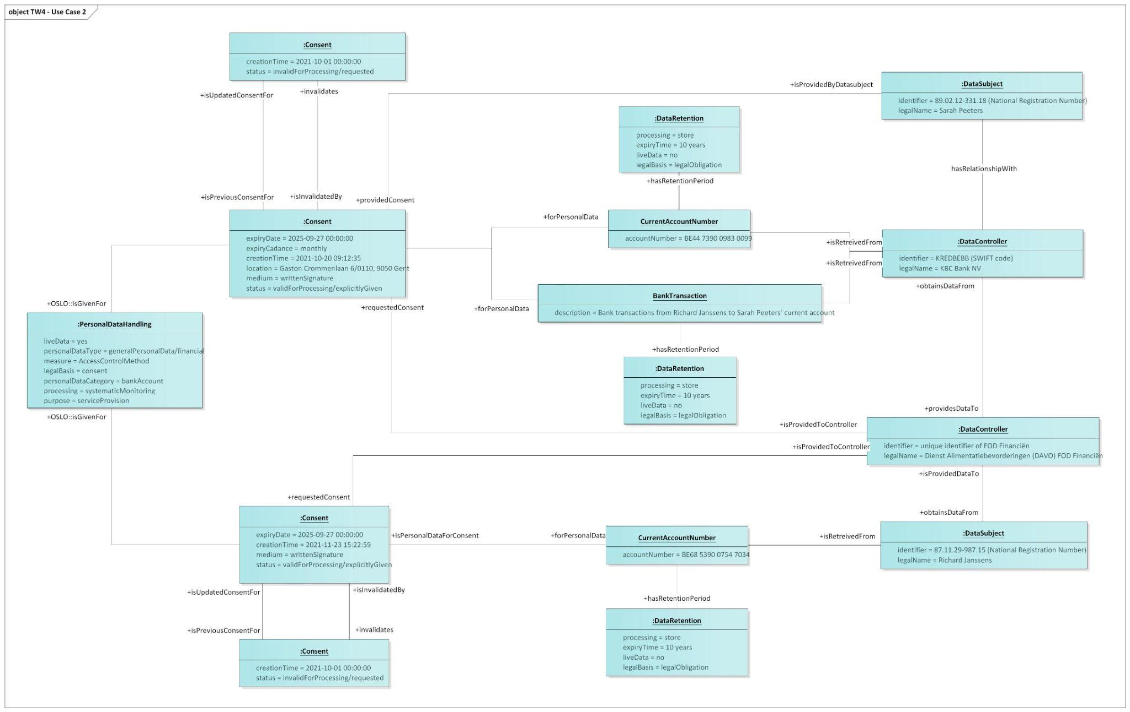
Case 1 – Multi-person consent for bank transfer data in function of Alimony support

Slide 38
Case 2 – Delegating consent to a family member for sharing medical information
Jim Doe has the genetic possibility to suffer from a genetic heart disease of which his father is suffering. To help Jim with his doctor visits, John gave him a delegation for consent to access John’s medical files with doctors.
On the 21th of November Jim goes for a consultation with a heart specialist named Harry Scott. During the consultation, the specialist indicates that it would be useful for him to access the medical file of his father so that he can get a better understanding on how the disease develops within Jim’s family. The files are controlled by the family doctor of John and Jim, named Peter Peeters. And so, Jim gives the specialist consent to access the medical files - controlled by Peter Peeters - during the consultation.
Of course for the delegation of the consent to be valid, the doctor must be a legally registered doctor. Hence, he needs to login with his eID in the systems to proof he is officially part of the “Orde der Artsen”.

Slide 39
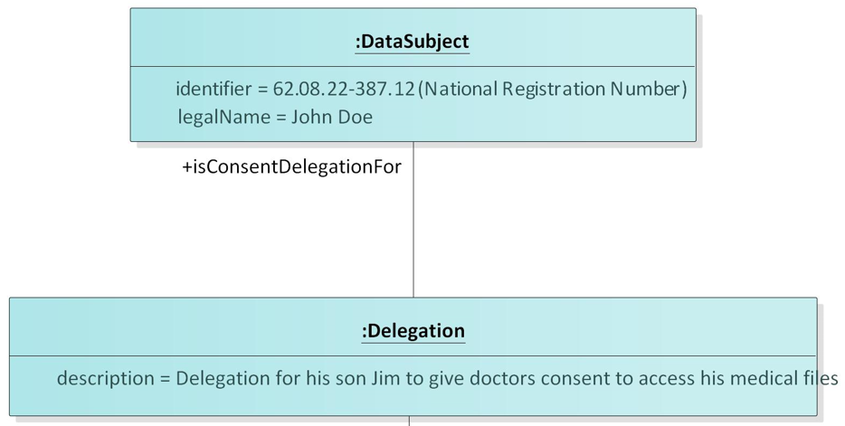
1. To help Jim with his doctor visits, John gave him a delegation for consent to access John’s medical files with doctors.
John is identified via his NRN
A delegation is in place for Jim to give doctors consent to process John’s medical files

Slide 40
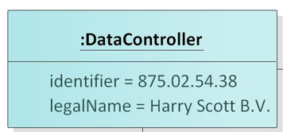
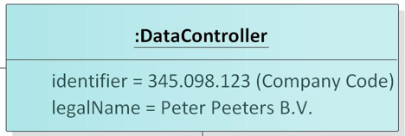
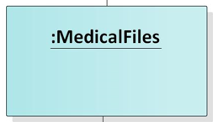
2. Jim consults a heart specialist who asks consent to consult the medical files of Jim's father
Harry Scott: the heart specialist which requests access to the data
Peter Peeters: the family doctor of the family Doe, who is controlling the data
Medical files: the personal data for which consent is requested

Slide 41
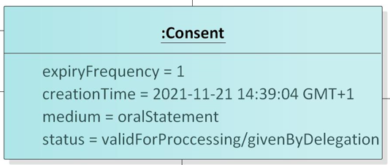
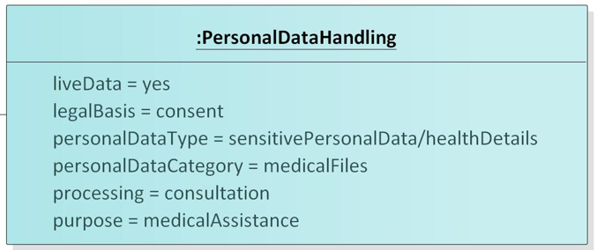
3. Dr. Scott requests consent to consult the data for medical purposes during Jim’s consultation
The consent was created during the consultation and given via an oral statement of Jim
The expiry frequence of 1 indicates that the consent will terminate after the doctor has consulted the data during the consultation
The data needs to be live
The doctor will consult the data to give medical assistance to Jim

Slide 42

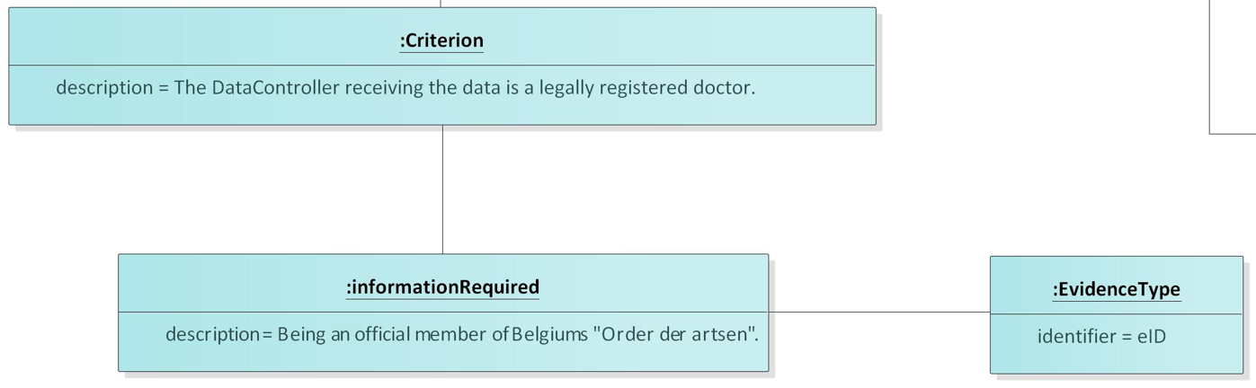
4. For the consent to be valid the doctor needs to be legally registered
As the delegation for consent was only valid in the case of the data controller being a legally registered doctor the CCCEV objects are being used
By logging into the system with his eID, the doctor automatically indicates that he is part of the list of the “Orde der artsen”

Slide 43
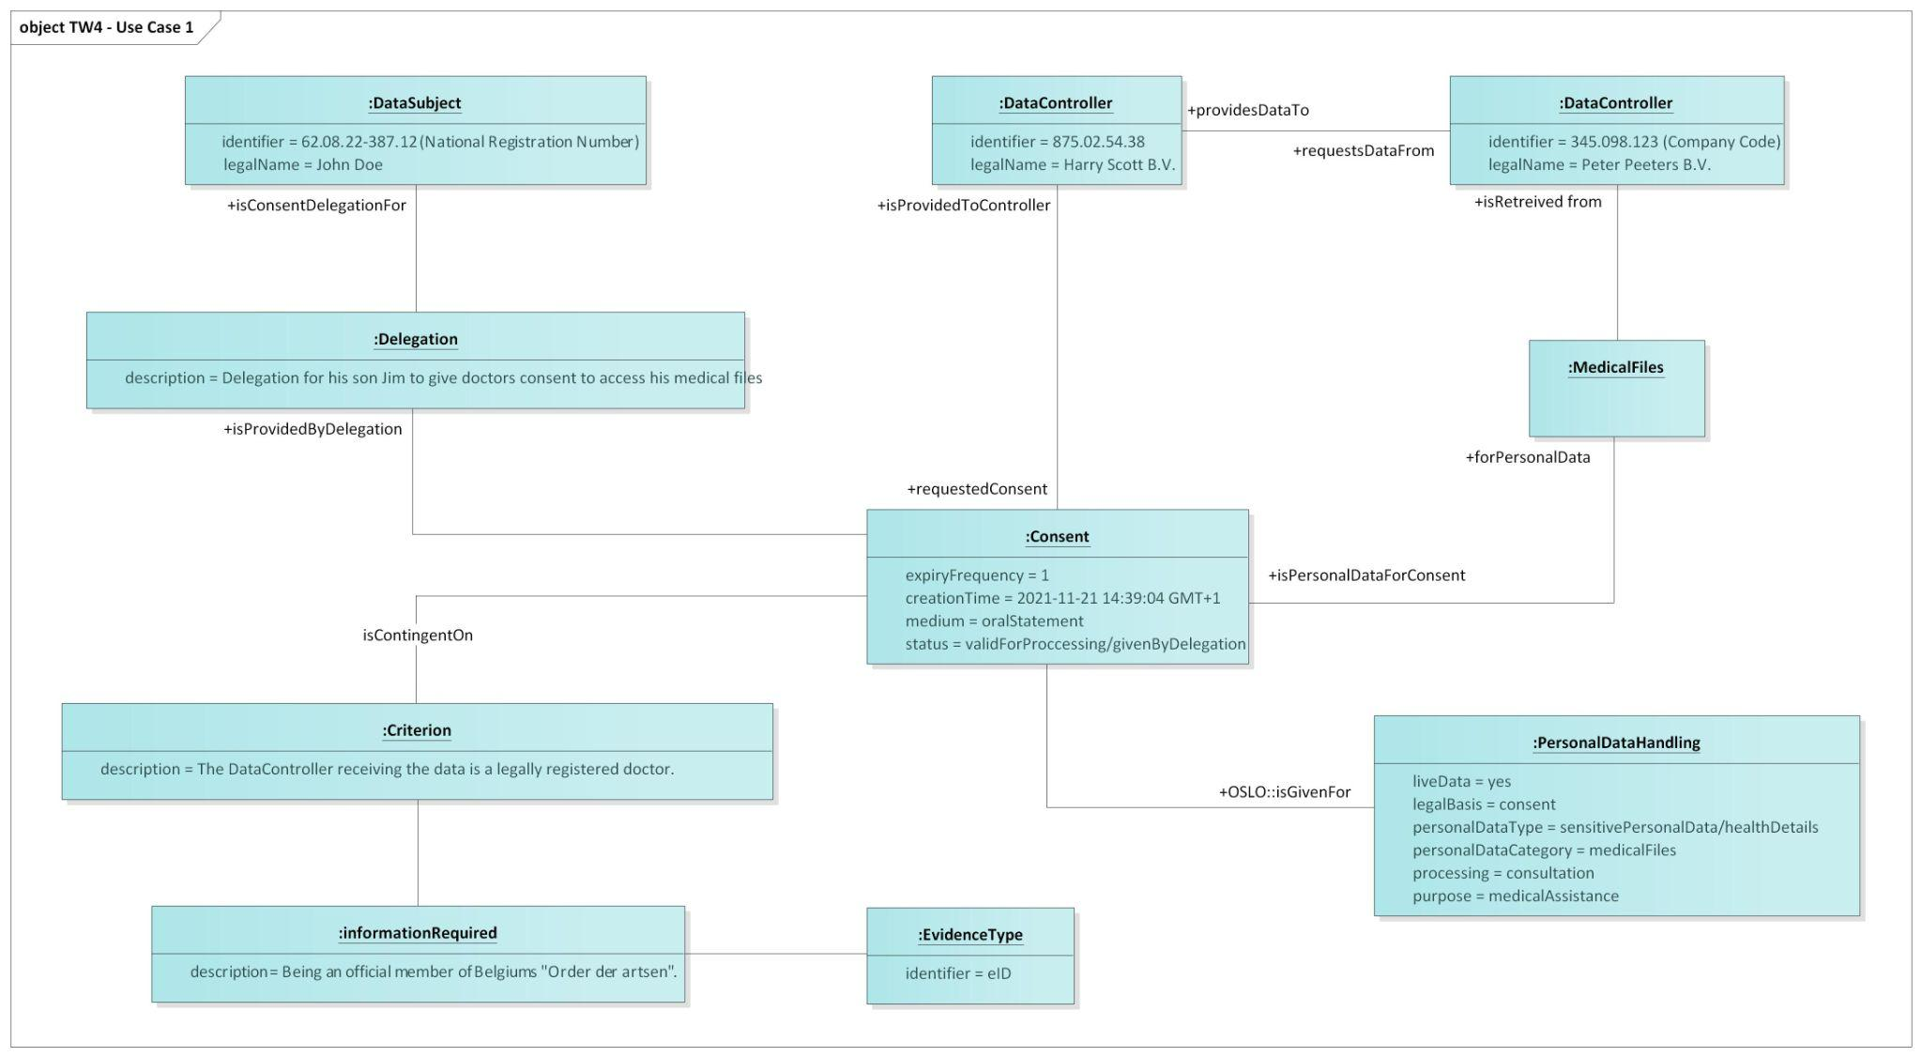
Case 2 – Delegating consent to a family member for sharing medical information

Slide 44
Definitions
Digitaal Vlaanderen

Slide 45
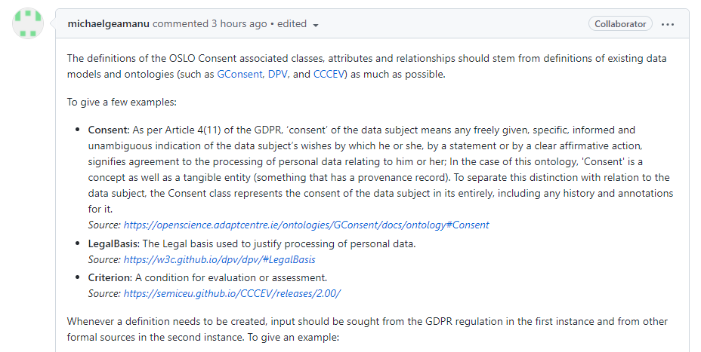
Definitions for the application profile

Slide 46
Practical exercise - Definition of the class ‘DataRetention’
“The retention of the personal data which should be lawful where it is necessary, for exercising the right of freedom of expression and information, for compliance with a legal obligation, for the performance of a task carried out in the public interest or in the exercise of official authority vested in the controller, on the grounds of public interest in the area of public health, for archiving purposes in the public interest, scientific or historical research purposes or statistical purposes, or for the establishment, exercise or defence of legal claims.” Source: https://eur-lex.europa.eu/eli/reg/2016/679/oj
Provide your input by posting in chat:
+1 = Agree
- 1 = Disagree
0 = Indifferent

Slide 47

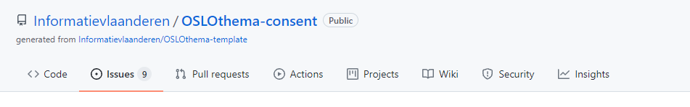
Definitions for the application profile
If you have further comments about the model or the definitions, you can always log them via Github or send them by email.
https://github.com/Informatievlaanderen/OSLOthema-consent/issues

Slide 48
Q&A and next steps
Digitaal Vlaanderen

Slide 49

Why do we do ... ?
Wouldn’t it be better if we ... ?
Don’t we need to add ... ?
What about ... ?

Slide 50
Next steps
Process all input from this workshop
Send out the report from this workshop
Capture feedback via GitHub! Feedback is welcome on the whole application profile which will be made available at the end of December (as draft) on test.data.vlaanderen.be. Please leave your feedback on the definitions, the data model, the reports and/or the presentations.

Slide 51
Feedback
Feedback can be given via mail to the contacts below:
michael.geamanu@vlaanderen.be
lora.van.looveren@pwc.com
Feedback can be given via GitHub on the link below:
https://github.com/Informatievlaanderen/OSLOthema-consent

Slide 52
Next step: Public review
2020
2021
August
September
October
November
December
January
February
March
April
May
June
Implementation of draft specifications
Start of public review at the end of December
Business workshop
4 thematic workshops
Today
Final webinar
Final validation of the standard

Slide 53
Thank you!

